Slide 1
Mining Data Streams

Slide 2
Agenda
Streams Concepts,
Stream Data Model and Architecture, stream computing,
Filtering Streams,
Estimating Moments,
Decaying window,
Real time Analytics Platform (RTAP) Applications

Slide 3

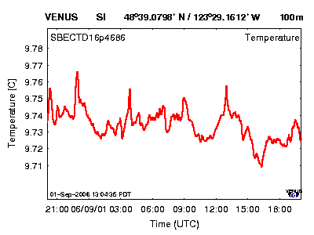

Introduction
Characteristics of Data streams are:
Continuous flow of data
Examples:
Network traffic
Sensor data
Call center records
Notes:
Data streams are
Continuous flows of data
For example, network traffic, sensor data, and call center records
3

Slide 4
Mining Data Streams(DS)
Mining data streams involves analyzing continuously generated data in real-time or near real-time to extract useful insights or patterns.
Mining DS is crucial for many real-time applications across various domains, including IoT, finance, e-commerce, healthcare, and more.
Effective stream processing systems and algorithms are essential for extracting timely insights and enabling proactive decision-making based on continuously evolving data.

Slide 5
Key Characteristics of Data Stream Mining
Continuous & Infinite Data Flow
Unlike traditional datasets, data streams are unbounded (no fixed size) and keep arriving continuously (e.g., sensor data, social media feeds, financial transactions).
Real-Time Processing
The system must process data on-the-fly, as it arrives, because storing it all is often not feasible.
Memory Constraints
Limited memory is used to handle large or infinite input, so data must be processed with lightweight, memory-efficient algorithms.
Concept Drift
The patterns or distributions in the stream may change over time, requiring adaptive models that evolve with the data.

Slide 6
Streams Concepts
Data Streams: Data streams represent continuously flowing, potentially unbounded sequences of data records. Examples include sensor data, social media feeds, financial transactions, etc.
Stream Processing: Stream processing refers to the real-time or near real-time analysis of data streams to extract insights, detect patterns, or make decisions as the data arrives.
Event Time vs. Processing Time: Event time refers to the time when an event actually occurred, while processing time refers to the time when an event is observed by the processing system.

Slide 7
Examples of Stream Sources
Sensor Data Imagine a temperature sensor bobbing about in the ocean, sending back to a base station a reading of the surface temperature each hour. The data produced by this sensor is a stream of real numbers.
Image Data Satellites often send down to earth streams consisting of many terabytes of images per day.
Internet and Web Traffic A switching node in the middle of the Internet receives streams of IP packets from many inputs and routes them to its outputs.

Slide 8
Characteristics of Data Streams
Data Streams
Data streams—continuous, ordered, changing, fast, huge amount
Traditional DBMS—data stored in finite, persistent data sets
Characteristics
Huge volumes of continuous data, possibly infinite
Fast changing and requires fast, real-time response
Data stream captures nicely our data processing needs of today
Random access is expensive—single scan algorithm (can only have one look)
Store only the summary of the data seen thus far
Most stream data are at pretty low-level or multi-dimensional in nature, needs multi-level and multi-dimensional processing

Slide 9
DBMS versus DSMS
Persistent relations
One-time queries
Random access
“Unbounded” disk store
Only current state matters
No real-time services
Relatively low update rate
Data at any granularity
Assume precise data
Access plan determined by query processor, physical DB design
Transient streams
Continuous queries
Sequential access
Bounded main memory
Historical data is important
Real-time requirements
Possibly multi-GB arrival rate
Data at fine granularity
Data stale/imprecise
Unpredictable/variable data arrival and characteristics
Ack. From Motwani’s PODS tutorial slides

Slide 10
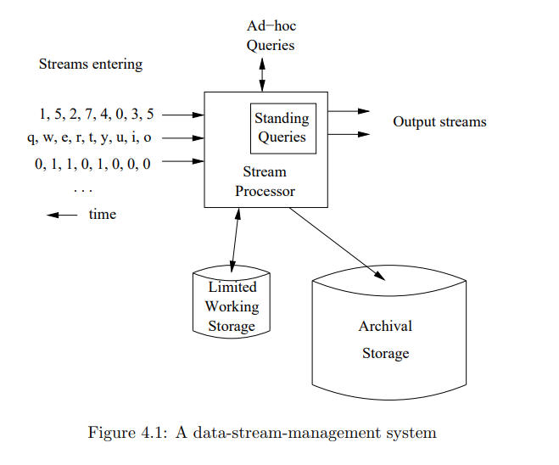
Stream Data Model

Slide 11
Stream data model
Streams Entering
Incoming data streams are shown as sequences:
Numbers (e.g., 1, 5, 2, 7, 4, 0, 3, 5)
Characters (e.g., q, w, e, r, t, y, u, i, o)
Binary/boolean values (e.g., 0, 1, 1, 0, 1, 0, 0, 0)
These data values arrive continuously over time.
Stream Processor
The Stream Processor is the core component that processes incoming streams.
It supports:
Standing Queries (continuous queries that run as new data arrives)
Ad-hoc Queries (queries submitted by users at any time)

Slide 12
Stream data model
Output Streams
Results of queries are emitted as output streams, which may themselves be used for further analysis or actions.
Limited Working Storage
This indicates that only a small portion of data is held in memory, usually through techniques like windowing (e.g., sliding/tumbling windows).
Archival Storage
Older or full stream data may be stored in archival storage for long-term analysis, auditing, or backup.

Slide 13
Architecture: Stream Query Processing
SDMS (Stream Data Management System)
User/Application
Continuous Query
Results
Multiple streams
Stream Query
Processor
Scratch Space
(Main memory and/or Disk)

Slide 14
Challenges
Infinite length
Concept-drift
Concept-evolution
Notes:
14

Slide 15


Infinite Length
Impractical to store and use all historical data
Requires infinite storage
And running time
0
1
0
1
1
1
0
0
0
1
0
1
Notes:
Naturally, data streams are infinite
Therefore, it is impractical to store and use all the historical data
As it would require infinite storage
And infinite running time to build the classification model
15

Slide 16
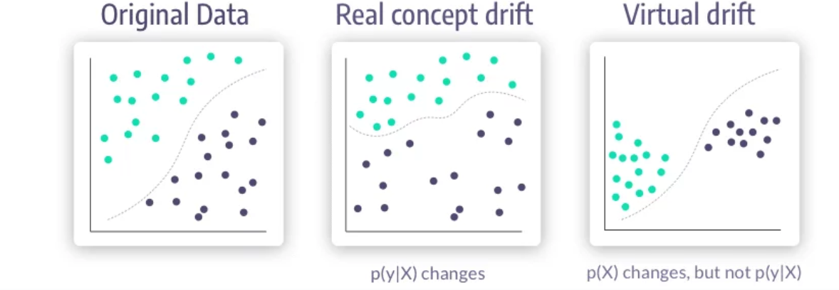
Concept-Drift
Concept Drift in ML is a situation where the statistical properties of the target variable (what the model is trying to predict) change over time.

Slide 17
Concept Drift
Original Data (No Drift)
The data points are well separated.
The model has learned a decision boundary based on the initial data distribution.
Both the distribution of features p(X) and labels p(Y|X) are stable.
Real Concept Drift
p(Y|X) changes: The relationship between features and the target variable has changed.
Example: A previously spammy word may now be used legitimately.
This directly affects model accuracy and requires model retraining or adaptation.
Virtual Drift
p(X) changes but p(Y|X) stays the same: The distribution of input features changes, but the target outcome based on those features remains consistent.
Example: New user behavior patterns emerge, but the classification rule stays the same.

Slide 18
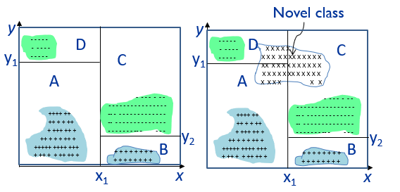
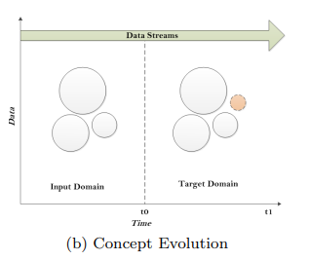
Concept-Evolution
Evolution is the emergence of novel classes.
Novel class detection refers to the problem of detecting the emergence of novel classes in the data stream.
A class is novel when the instances belonging to it have not been observed before.

Slide 19
Challenges of Stream Data Processing
Multiple, continuous, rapid, time-varying, ordered streams
Main memory computations
Queries are often continuous
Evaluated continuously as stream data arrives
Answer updated over time
Queries are often complex
Beyond element-at-a-time processing
Beyond stream-at-a-time processing
Beyond relational queries (scientific, data mining, OLAP)
Multi-level/multi-dimensional processing and data mining
Most stream data are at low-level or multi-dimensional in nature

Slide 20
Processing Stream Queries
Query types
One-time query vs. continuous query (being evaluated continuously as stream continues to arrive)
Predefined query vs. ad-hoc query (issued on-line)
Unbounded memory requirements
For real-time response, main memory algorithm should be used
Memory requirement is unbounded if one will join future tuples
Approximate query answering
With bounded memory, it is not always possible to produce exact answers
High-quality approximate answers are desired
Data reduction and synopsis construction methods
Sketches, random sampling, histograms, wavelets, etc.

Slide 21
Methodologies for Stream Data Processing
Major challenges
Keep track of a large universe, e.g., pairs of IP address
Methodology
Synopses (trade-off between accuracy and storage)
Use synopsis data structure, much smaller (O(log^{k} N) space) than their base data set (O(N) space)
Compute an approximate answer within a small error range (factor ε of the actual answer)
Major methods
Random sampling
Histograms
Sliding windows
Multi-resolution model

Slide 22
Stream Data Processing Methods
Random sampling (but without knowing the total length in advance)
Reservoir sampling: maintain a set of s candidates in the reservoir, which form a true random sample of the element seen so far in the stream. As the data stream flow, every new element has a certain probability (s/N) of replacing an old element in the reservoir.
Sliding windows
Make decisions based only on recent data of sliding window size w
An element arriving at time t expires at time t + w
Histograms
Approximate the frequency distribution of element values in a stream
Partition data into a set of contiguous buckets
Equal-width (equal value range for buckets) vs. V-optimal (minimizing frequency variance within each bucket)
Multi-resolution models
Popular models: balanced binary trees, micro-clusters, and wavelets

Slide 23
Approximate Query Answering in Streams
Sliding windows
Only over sliding windows of recent stream data
Approximation but often more desirable in applications
Batched processing, sampling and synopses
Batched if update is fast but computing is slow
Compute periodically, not very timely
Sampling if update is slow but computing is fast
Compute using sample data, but not good for joins, etc.
Synopsis data structures
Maintain a small synopsis or sketch of data
Good for querying historical data
Blocking operators, e.g., sorting, avg, min, etc.
Blocking if unable to produce the first output until seeing the entire input

Slide 24
Projects on DSMS (Data Stream Management System)
Research projects and system prototypes
STREAM (Stanford): A general-purpose DSMS
Cougar (Cornell): sensors
Aurora (Brown/MIT): sensor monitoring, dataflow
Hancock (AT&T): telecom streams
Niagara (OGI/Wisconsin): Internet XML databases
OpenCQ (Georgia Tech): triggers, incr. view maintenance
Tapestry (Xerox): pub/sub content-based filtering
Telegraph (Berkeley): adaptive engine for sensors
Tradebot (www.tradebot.com): stock tickers & streams
Tribeca (Bellcore): network monitoring
MAIDS (UIUC/NCSA): Mining Alarming Incidents in Data Streams

Slide 25
Stream Data Mining vs. Stream Querying
Stream mining—A more challenging task in many cases
It shares most of the difficulties with stream querying
But often requires less “precision”, e.g., no join, grouping, sorting
Patterns are hidden and more general than querying
It may require exploratory analysis
Not necessarily continuous queries
Stream data mining tasks
Multi-dimensional on-line analysis of streams
Mining outliers and unusual patterns in stream data
Clustering data streams
Classification of stream data

Slide 26
Stream Data Model and Architecture
Event: An event represents a data record in the stream, typically characterized by a timestamp and associated attributes.
Stream Processing Architecture: Stream processing architectures typically involve components for data ingestion, processing, analysis, and output. These components may include messaging systems (e.g., Apache Kafka), stream processing engines (e.g., Apache Flink, Apache Spark Streaming), and storage systems (e.g., databases, data lakes).

Slide 27
Stream Computing
Stateful Stream Processing: Stateful stream processing involves maintaining and updating state information across multiple events in the stream. This enables tasks such as sessionization, pattern detection, and anomaly detection.
Windowing: Windowing divides the stream into finite segments or windows, allowing computations to be performed over fixed time intervals or based on a fixed number of events. Common window types include tumbling windows, sliding windows, and session windows.

Slide 28
Filtering Streams
Filtering: Filtering involves selecting or excluding events from the stream based on specified criteria. This can be done using predicates or conditional expressions

Slide 29
Estimating Moments
Moments: Moments are statistical measures of the distribution of data. Common moments include mean, variance, skewness, and kurtosis.
Estimating Moments in Data Streams: Estimating moments in data streams involves continuously updating estimates of statistical moments as new data arrives. Techniques such as reservoir sampling, sketching algorithms (e.g., Count-Min Sketch), and approximate algorithms are often used to efficiently compute moment estimates in data streams.

Slide 30
Decaying Window
Decaying Window: A decaying window gives more weight to recent events in the stream while gradually reducing the influence of older events. This is particularly useful for capturing trends or detecting changes in data distributions over time.

Slide 31
Real-Time Analytics Platform (RTAP) Applications
Real-Time Monitoring and Alerting: RTAPs can be used for monitoring systems or processes in real-time and generating alerts or notifications based on predefined conditions or anomalies.
Fraud Detection and Anomaly Detection: RTAPs enable real-time detection of fraudulent activities or anomalous behavior by analyzing streaming data and identifying patterns that deviate from normal behavior.
Personalized Recommendations: RTAPs can analyze user interactions and behaviors in real-time to generate personalized recommendations or content suggestions.
Predictive Maintenance: RTAPs analyze sensor data from industrial equipment or machinery in real-time to detect potential failures or maintenance needs before they occur, thereby minimizing downtime and optimizing maintenance schedules.
Financial Trading and Algorithmic Trading: RTAPs analyze market data and execute trading strategies in real-time, enabling algorithmic trading and automated decision-making in financial markets.

